Slide 1
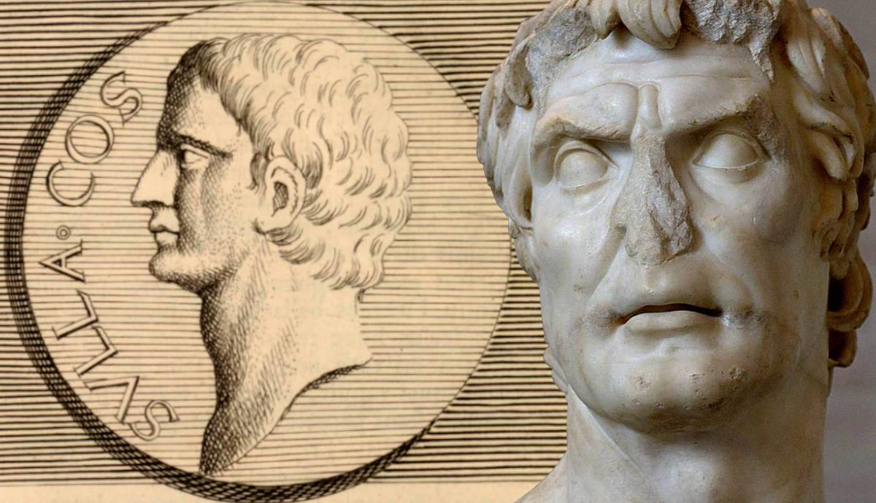
The Proscriptions
GOAL/S: Research and explain Sulla’s Proscriptions
Week 3, Lesson 2

Slide 2
INSTRUCTIONS
Log onto computer
Write your first and last name on the booklet provided
Go to the following website: https://www.historyskills.com/classroom/ancient-history/sulla-s-proscriptions/
Complete the booklet provided and submit to Ms Barrie

